Slide 1
Team 7
Climate Change
David Rak, Radhey Patel, Victoria Lara-Aguilar, Isabelle Goode
SI480 - 09 Initial Project Ideas

Slide 2
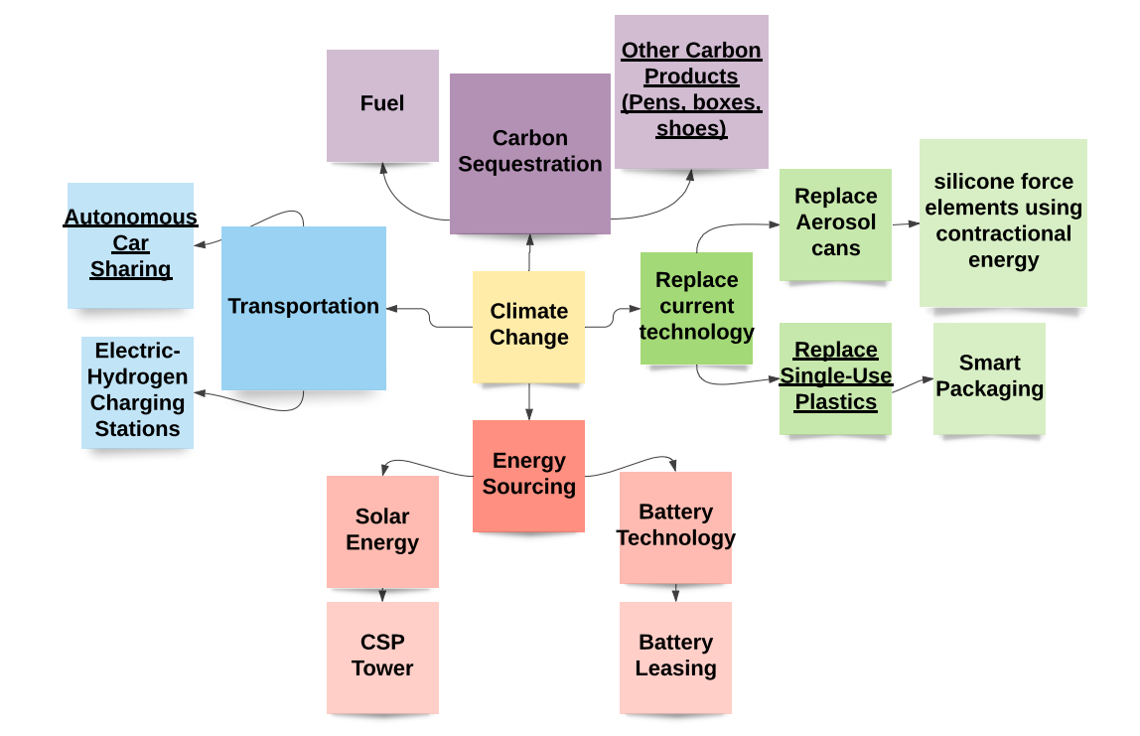
Fundamental Shift Map

Slide 3
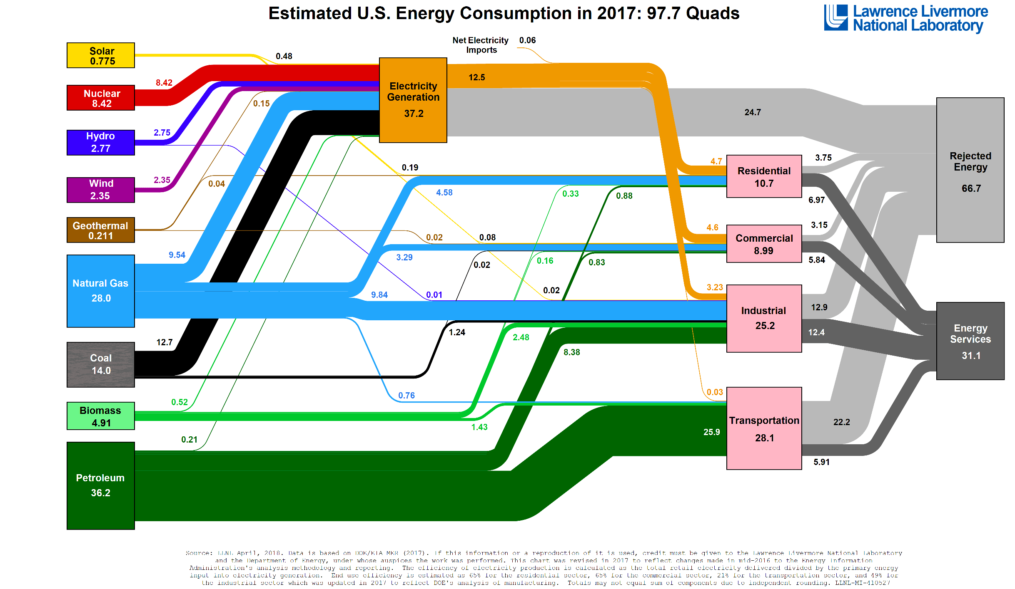
Source: https://flowcharts.llnl.gov/commodities/energy

Slide 4
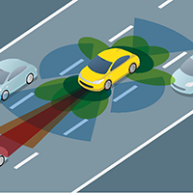
Idea 1: Autonomous Car Sharing Service
Main idea
Autonomous car network
Cars drive from pick-up to destination
The problem
Electric/clean fuel cars to reduce carbon emissions
Number of cars manufactured
Financing personal cars
Public transport
https://www.planning.org/knowledgebase/autonomousvehicles/

Slide 5
Idea 1: Autonomous Car Sharing Service
Value Proposition
No personal vehicles
Reduces carbon emissions
Cars are reused, recycled, and shared.
Greatest perceived need
Ride-sharing users
People in urban areas
Extrapolation
Shift towards green transportation
Autonomous Vehicle Network

Slide 6


Idea 2: Smart/Bio Packaging for Shipping
Main idea
Single-use plastics in shipping → smart/bio packaging
The Problem
Single-use waste.
Smart packaging → less packaging, enhances product use.
Biopackaging → renewable and compostable materials.

Slide 7
Idea 2: Smart/Bio Packaging for Shipping
Value Proposition
Shipped goods with cheaper/equivalent packaging.
Less waste from consumers and businesses.
Greatest perceived need
Online retailers and shipping companies.
Extrapolation
Replacing traditional plastic items for smart/bio packaging.
Food packaging with utensils, cups, etc.

Slide 8
Idea 3: Carbon Sequestration
Main Idea
Absorbing carbon dioxide from the atmosphere and for usable products.
The Problem
Removal of CO2 from the atmosphere.
Reducing the probability of the global average temperature rising over 2ºC .
Value Proposition
Products that reduce levels of atmospheric CO2 for retailers and consumers
Cleaner fuels for consumers

Slide 9
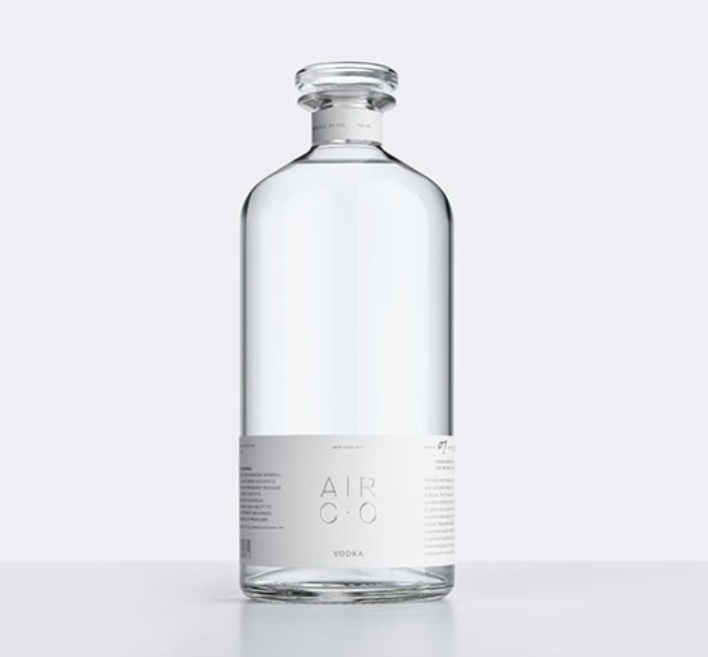

Idea 3: Carbon Sequestration
Greatest perceived need
Businesses seeking to create environmentally friendly products.
Stabilizes cost of fuel
Carbon-Neutral SynGas/Fuel.
Extrapolation
Clean transportation
Sequestered carbon fashion industry
Sequestered carbon alcohol industry/bars

